Slide 1
Sound Scope
Statistical Perspectives on Music Preferences: An Analysis of MLHD
Team Member: Keyu, Santiago, Qinuo

Slide 2
Table of contents
01
02
03
Data Overview
Multivariate Regression, Causal Inference, findings
Ethical Issue: Can we predict demographic features by behavior data?

Slide 3
Data: The Music Listening Histories Dataset (MLHD)
The Music Listening Histories Dataset (MLHD) is a large-scale collection of music listening events assembled from more than 27 billion time-stamped logs extracted from Last.fm.
Research Question: What demographic and behavioral factors most influence user engagement, and how can these insights inform effective platform strategies?
Core variables
Behavioral features(in artist, album & track dimensions):
Exploratoryness: Measures diversity in music exploration. Most users have high exploratory scores.
Mainstreamness: Captures preference for popular music. The majority of users prefer non-mainstream artists.
Genderedness: Indicates preference for music by gender-specific artists. There is significant variability in user engagement levels.
Fringeness: Measures inclination toward niche or less-known music. Fringeness scores exhibit wide variability across users.
Demographic features:
Age: Most users are young adults, with the majority falling between the ages of 18–30, and very few above 50.
Gender: Male users dominate(58.3%), female accounts for 23.4% and the rest are not defined.
Country: Users are predominantly from the U.S., U.K., and Germany.
Playcount: There is significant variability in user engagement.
User type: Regular users ("user") constitute the largest group, followed by smaller proportions of alumni, moderators, and staff. Subscribers represent a notable but smaller category.

Slide 4
Hypothesis
We hypothesize that user engagement (measured as monthly listening average) is influenced by demographic factors (age, gender, country/region) and behavioral preferences (e.g., mainstreamness and exploratoryness)
Main Hypothesis: Gender Effect
Null Hypothesis: Gender has no significant effect on monthly listening averages after controlling for age, mainstreamness, and exploratoryness.
Alternative Hypothesis: Gender has a significant effect on monthly listening averages after controlling for age, mainstreamness, and exploratoryness.
Secondary Hypotheses:
Older users are less engaged (negative relationship between age and engagement).
Users with higher mainstream preferences are less engaged.
Users with higher exploratory preferences are more engaged.
Notes:
Building the Predictive Model:
We grouped users by age into categories (e.g., "young," "senior") and listening duration ("low" to "very high").
Continuous variables like exploratoryness and mainstreamness were scaled for better comparison.
Created a normalized target variable: Monthly Listening Average.
Key Model Insights:
Significant factors influencing listening behavior include:
Listening Frequency: "Very high" listeners are the most engaged (+120 tracks/month).
Gender: Males listen to 56 more tracks/month compared to females.
Age: Seniors engage the least, with -85 fewer tracks/month.
Music Preferences: Exploratory users are more active, while mainstream preferences lower activity.

Slide 5
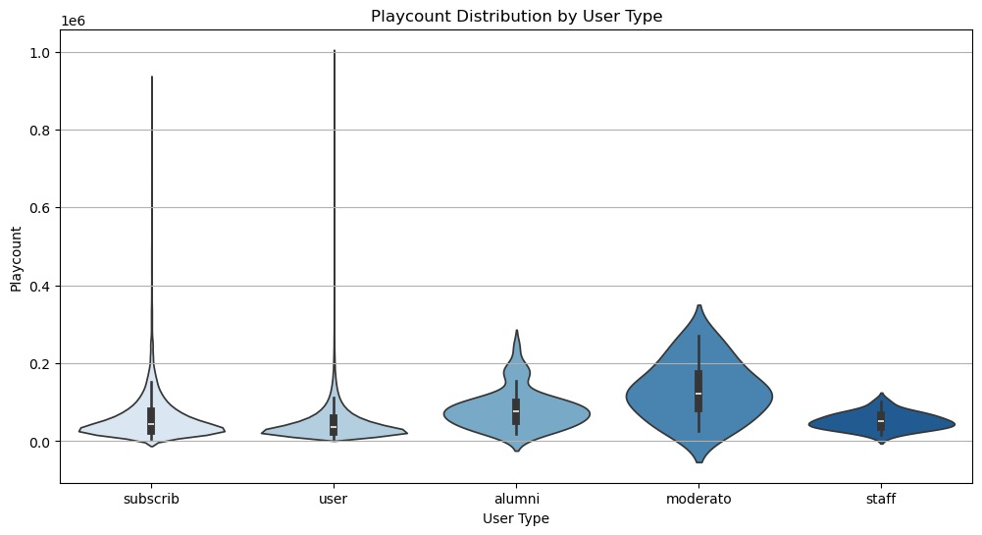
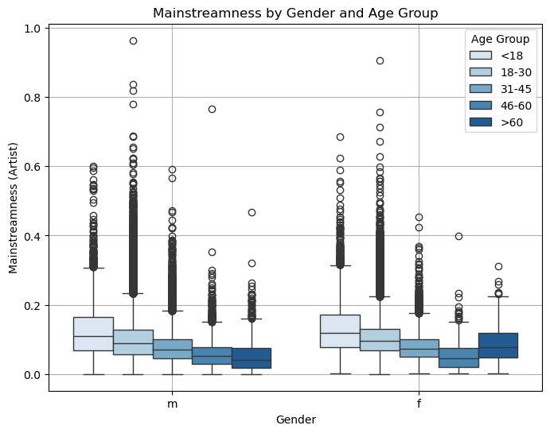
User Engagement and Behavioral Preferences
Younger Users: Higher mainstreamness among <30 users suggests algorithm recommendations would be effective.
Stable Gender Preferences: Similar median scores for males and females indicate gender-neutral mainstreamness preferences, with outliers revealing niche opportunities.
Older Users Value Niche: Lower mainstreamness scores among >45 users highlight potential for curated content.
Regular Users Drive Activity: Regular users dominate playcounts but show high variability, suggesting a need for targeted engagement strategies.
Subscriber Focus: Subscribers engage less dynamically despite paying status, highlighting retention improvement opportunities.
Moderators as Steady Engagers: Moderators exhibit consistent playcounts.

Slide 6
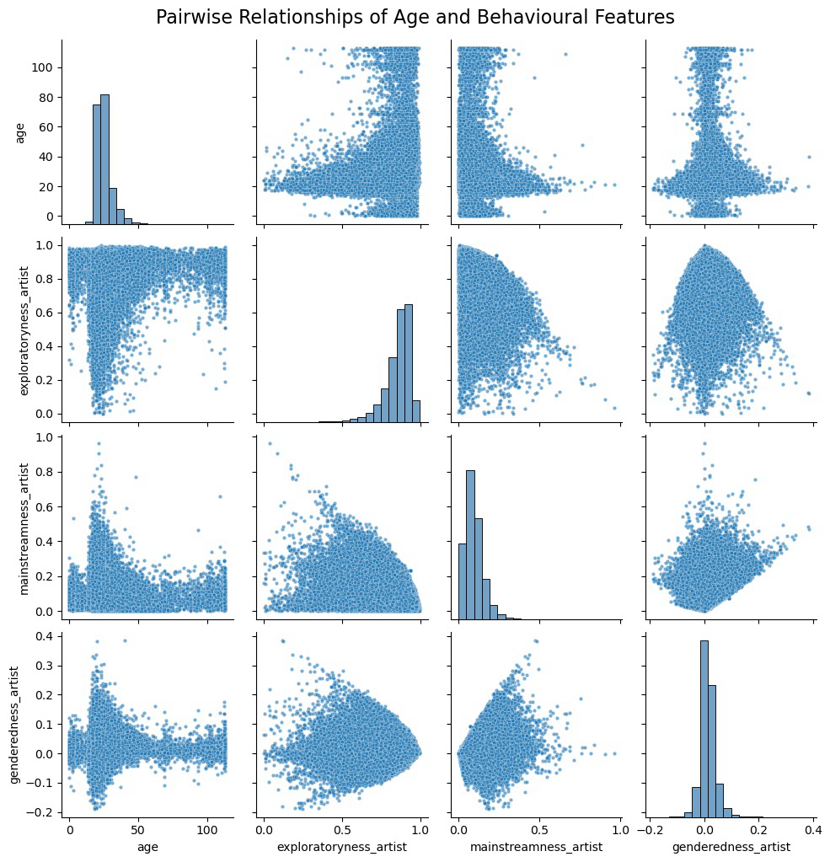
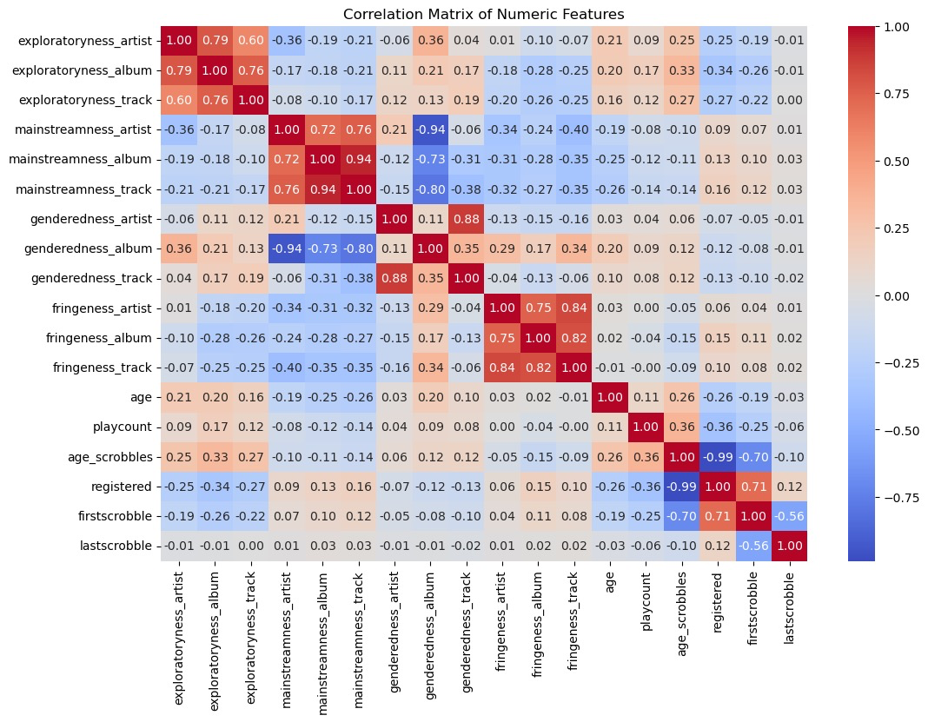
Correlation
Notes:
Positive relationships between behavioral dimensions like mainstreamness across artist and track. Younger users high variablility; Older users skew toward niche or less mainstream behaviors. == suggests introducing interaction terms into regression models

Slide 7
Empirical Model
To test these hypotheses, we use the following linear regression model:
Where:
Yi: Monthly listening average for user i (target variable).
Genderi: Dummy variable (1 = male, 0 = female).
Agei: Continuous variable representing the age of user i.
Mainstreamnessi: Scaled score for user iii’s preference for mainstream music.
Exploratorynessi​: Scaled score for user iii’s tendency to explore diverse music.
ϵi: Error term capturing unobserved factors influencing listening behavior.
Notes:
Building the Predictive Model:
We grouped users by age into categories (e.g., "young," "senior") and listening duration ("low" to "very high").
Continuous variables like exploratoryness and mainstreamness were scaled for better comparison.
Created a normalized target variable: Monthly Listening Average.
Key Model Insights:
Significant factors influencing listening behavior include:
Listening Frequency: "Very high" listeners are the most engaged (+120 tracks/month).
Gender: Males listen to 56 more tracks/month compared to females.
Age: Seniors engage the least, with -85 fewer tracks/month.
Music Preferences: Exploratory users are more active, while mainstream preferences lower activity.

Slide 8
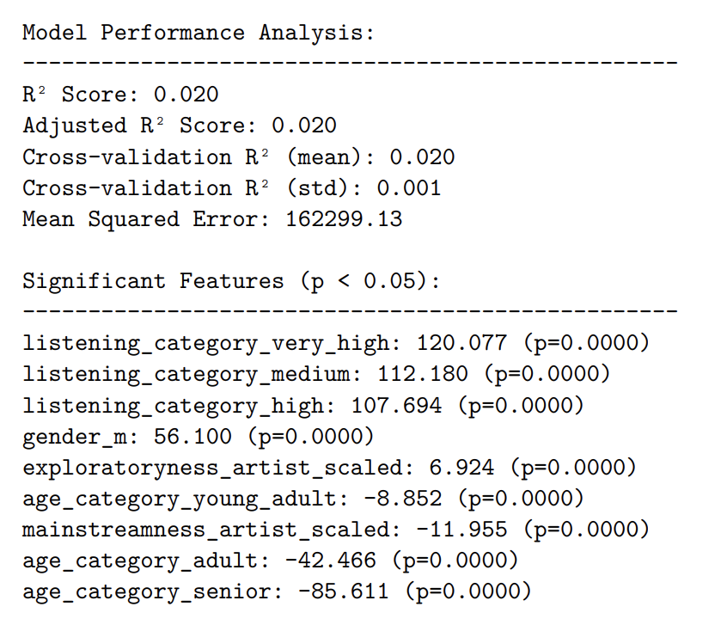
Regression Analysis: Building the Predictive Model
Overall Model Performance:
The model explains 2% of the variation in user listening behavior (R² = 0.020).
This means most of the factors influencing engagement weren’t captured, but the findings are still statistically valid.
Significant Features:
High Listening Activity: Users in the "very high" listening category listen to 120 more tracks per month compared to those in the "low" category.
Gender: Male users listen to 56 more tracks/month than females.
Age: Listening decreases with age:
Seniors: -85 fewer tracks/month.
Adults: -42 fewer tracks/month.
Music Preferences:
Exploratory users are slightly more active (+6.9 tracks/month).
Mainstream preferences reduce activity (-12 tracks/month)
.
Notes:
Building the Predictive Model:
We grouped users by age into categories (e.g., "young," "senior") and listening duration ("low" to "very high").
Continuous variables like exploratoryness and mainstreamness were scaled for better comparison.
Created a normalized target variable: Monthly Listening Average.
In this part of my analysis, I focused on building and validating a robust predictive model for user behavior. First, I simplified the features by creating meaningful categories for age and listening duration using quartiles, which helped make the results more interpretable. I divided users into groups like 'young', 'young_adult', 'adult', and 'senior' for age, and 'low' to 'very_high' for listening duration.
I then prepared my feature set by combining scaled continuous variables (exploratoryness and mainstreamness) with categorical variables. I created dummy variables for the categorical features, being careful to drop one category from each to avoid multicollinearity.
For the target variable, I created a more meaningful metric - the monthly listening average - by normalizing playcount by listening duration. I then handled outliers using the IQR method and removed any missing values to ensure data quality.
I implemented k-fold cross-validation (k=5) to assess model stability and prevent overfitting. This gave me a more reliable estimate of model performance than a single train-test split would provide. The cross-validation results showed consistent performance across folds, with a mean R² of about 0.02 and low standard deviation, indicating stable but modest predictive power.
Finally, I fitted a final model using robust standard errors (HC3) to account for potential heteroskedasticity, and visualized the significant features to understand their relative importance. The low R² suggests that while we found statistically significant relationships, there are likely other important factors influencing listening behavior that weren't captured in our current model.

Slide 9
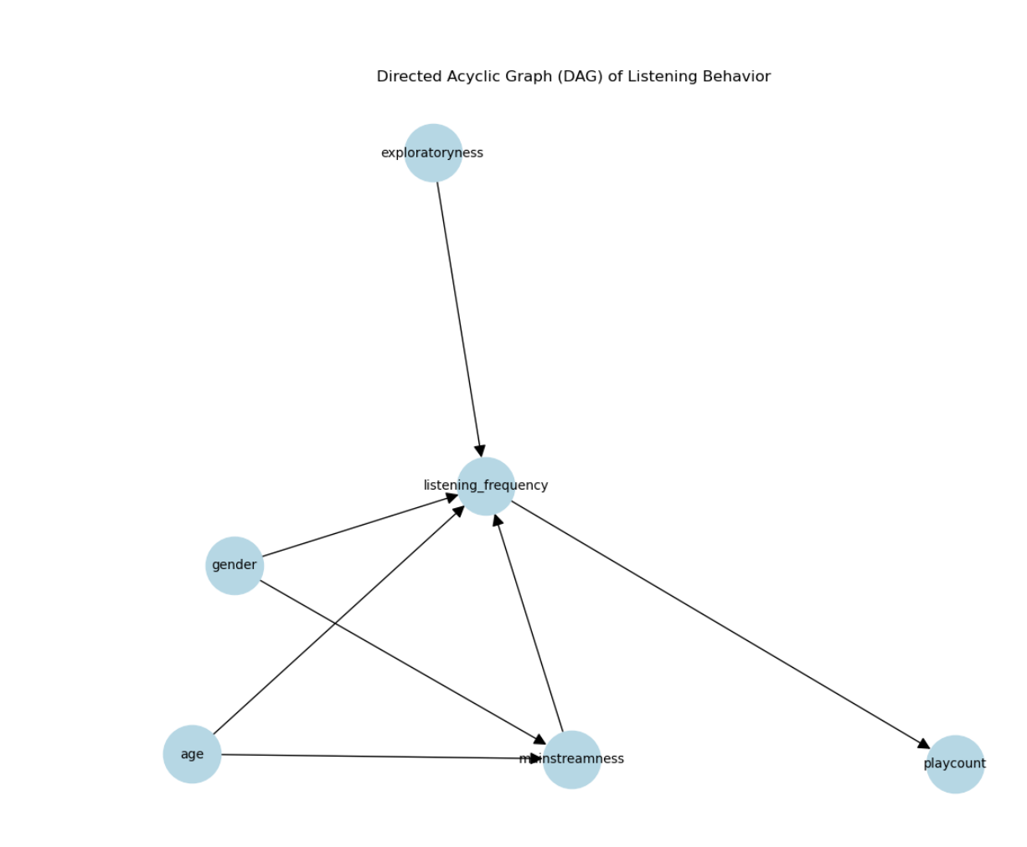
Causal Inference - DAG Interpretation
Gender and Age influence listening behavior directly and indirectly through Mainstreamness and Exploratoryness.
Listening Frequency is the central variable influenced by these factors, which then affects Playcount (overall engagement).
Purpose:
Identified confounders (age, mainstreamness, exploratoryness) that could bias the analysis of gender’s effect on listening behavior.
Helped prioritize which variables needed to be controlled for accurate causal estimation.
Notes:
In this part of my analysis, I focused on implementing causal inference techniques to understand the effect of gender on listening behavior. I started by creating dummy variables for gender and preparing my data by removing missing values in key variables like age, mainstreamness, and exploratoryness.
I first created a Directed Acyclic Graph (DAG) to visualize and understand the theoretical causal relationships between variables. This helped me identify potential confounding factors and determine which variables needed to be controlled for in my analysis. The DAG showed how factors like age and gender might influence listening behavior both directly and through intermediate variables like mainstreamness preferences.
Then, I implemented Propensity Score Matching (PSM) to reduce selection bias and create more comparable groups. This technique helped me match male and female users who were similar in terms of age, mainstreamness, and exploratoryness, allowing for a more accurate estimation of gender's effect on listening behavior. I carefully tracked the matching process, ensuring both treatment (male) and control (female) groups had sufficient samples.
To validate the quality of my matching, I conducted balance tests using t-tests before and after matching. I visualized the distributions of covariates for both groups using kernel density plots, which helped me confirm whether the matching improved the comparability of the groups.
Finally, I calculated the Average Treatment Effect (ATE) to quantify how gender influences monthly listening averages. The visualization of covariate distributions before and after matching helped me confirm whether the PSM successfully balanced the groups and made them more comparable.

Slide 10
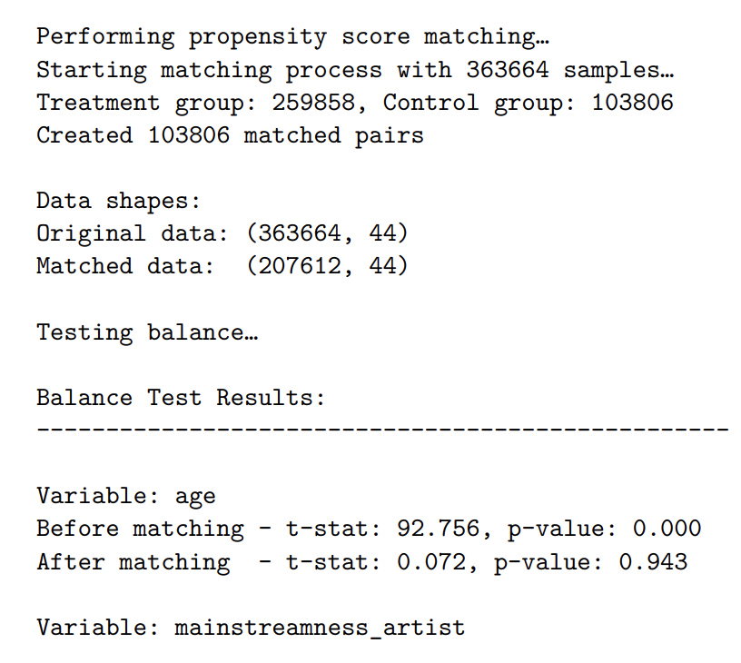
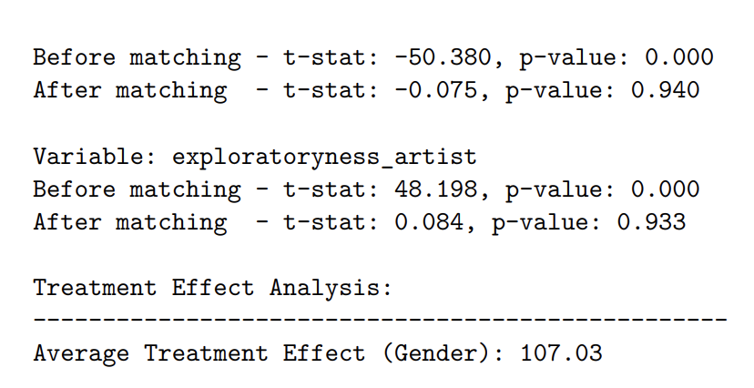
Propensity Score Matching (PSM):
Goal: Compare male and female users with similar characteristics to isolate gender’s effect on listening behavior.
Steps:
Matched male (treatment) and female (control) users based on age, mainstreamness, and exploratoryness.
Created 103,806 matched pairs, resulting in a balanced dataset of 207,612 users.
Conducted balance tests to validate the matching process:
Before matching: Significant differences between males and females (e.g., t-stat for age = 92.756, p < 0.001). Meaning males and females weren’t directly comparable.
After matching: Groups were well-balanced and differences eliminated (t-stat for age = 0.072, p = 0.943).
Purpose: This allows us to isolate the effect of gender on listening behavior without bias from other factors like age or music preferences.
Notes:
Then, I implemented Propensity Score Matching (PSM) to reduce selection bias and create more comparable groups. This technique helped me match male and female users who were similar in terms of age, mainstreamness, and exploratoryness, allowing for a more accurate estimation of gender's effect on listening behavior. I carefully tracked the matching process, ensuring both treatment (male) and control (female) groups had sufficient samples.
To validate the quality of my matching, I conducted balance tests using t-tests before and after matching. I visualized the distributions of covariates for both groups using kernel density plots, which helped me confirm whether the matching improved the comparability of the groups.
Why it’s done:
Before Matching: There were significant differences (e.g., age t-stat = 92.756), meaning males and females weren’t directly comparable.
After Matching: These differences were eliminated (e.g., age t-stat = 0.072, p = 0.943), creating two groups that are similar except for gender.
Purpose: This allows us to isolate the effect of gender on listening behavior without bias from other factors like age or music preferences.
The t-stat measures the size of the difference between two groups (e.g., males and females) relative to the variability in the data.
A large t-stat (e.g., 92.756) means the groups are very different.
A small t-stat (e.g., 0.072) means the groups are nearly identical.
The p-value tells us whether the difference is statistically significant.
A small p-value (e.g., < 0.001) means the difference is unlikely due to chance.
A large p-value (e.g., 0.943) means the difference is not statistically significant.

Slide 11
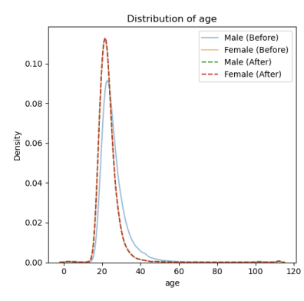
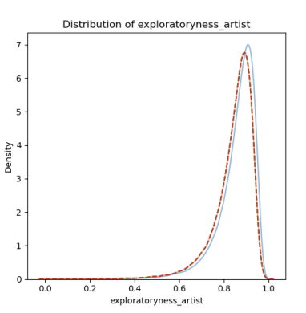
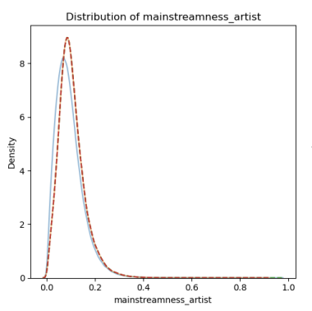
Propensity Score Matching (PSM):
Covariates Distribution
Findings:
The Average Treatment Effect (ATE) was +107 tracks/month, meaning:
On average, male users listen to 107 more tracks per month than matched female users.
Post-matching balance tests confirmed the groups were comparable, reducing bias in the estimate.
Significance:
The ATE highlights a clear gender difference in listening behavior after controlling for confounders, suggesting gender plays a notable role in engagement.
Key Takeaway:
The DAG helped identify confounders, and propensity score matching successfully created balanced groups. This allowed for a robust causal analysis, showing that gender significantly influences listening behavior, with males being more engaged than females.
Notes:
The DAG represents the theoretical causal relationships between variables in the dataset.

Slide 12
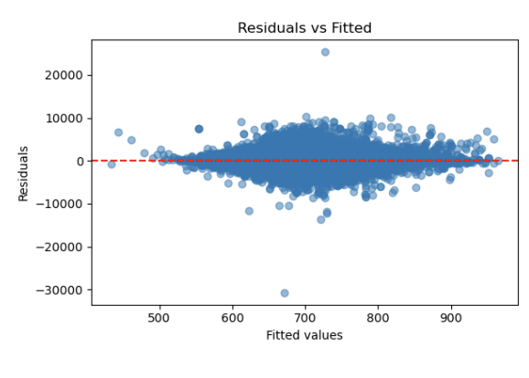
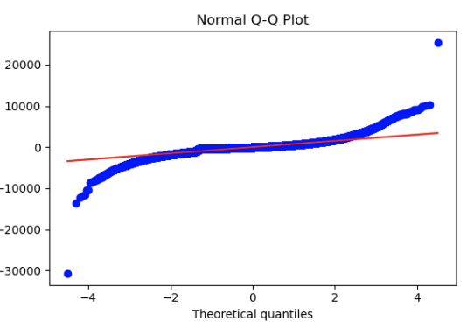
Model Diagnostics
White’s Test for Heteroskedasticity:
What we found: Variance of errors changes across predictions, the model is heteroskedastic (p < 0.001).
Solution: Using robust standard errors accounts for the unequal error variance, making the results (p-values and confidence intervals) accurate and reliable even in the presence of heteroskedasticity
2. Variance Inflation Factors (VIF):
What we found: Predictors like age, mainstreamness, and exploratoryness have very low overlap (VIF < 1.2). indicating minimal multicollinearity, meaning the predictors are mostly independent.
Notes:
Next, I calculated Variance Inflation Factors (VIF) to detect multicollinearity among my predictors. This helps identify if any independent variables are too highly correlated with each other, which could make the model unstable and difficult to interpret.
I also created visual diagnostics to complement these statistical tests. I plotted residuals versus fitted values to check for patterns that might indicate violations of model assumptions, and created a Q-Q plot to assess whether the residuals follow a normal distribution. The residuals vs. fitted plot helps identify any non-linear patterns or heteroskedasticity, while the Q-Q plot helps verify the normality assumption.
Visual Diagnostics
Residuals vs. Fitted Plot:
Shows no clear patterns, indicating no major non-linear relationships or omitted variables.
Residual spread confirms heteroskedasticity, supporting the results of White’s test.
Normal Q-Q Plot:
Deviations from the diagonal suggest the residuals aren’t perfectly normally distributed.
This is a minor violation but doesn’t critically impact the analysis with robust standard errors applied.
3. Key Findings
Predictor Relationships:
Age: Slight negative effect on listening behavior (-0.99 tracks/month), suggesting older users listen less.
Mainstreamness: Strong negative effect (-547 tracks/month), indicating mainstream preferences reduce engagement.
Exploratoryness: Also negatively associated (-277 tracks/month), possibly due to diverse user behaviors.
Model Assumptions:
Heteroskedasticity detected but addressed with robust methods.
Minimal multicollinearity ensures predictor stability.

Slide 13
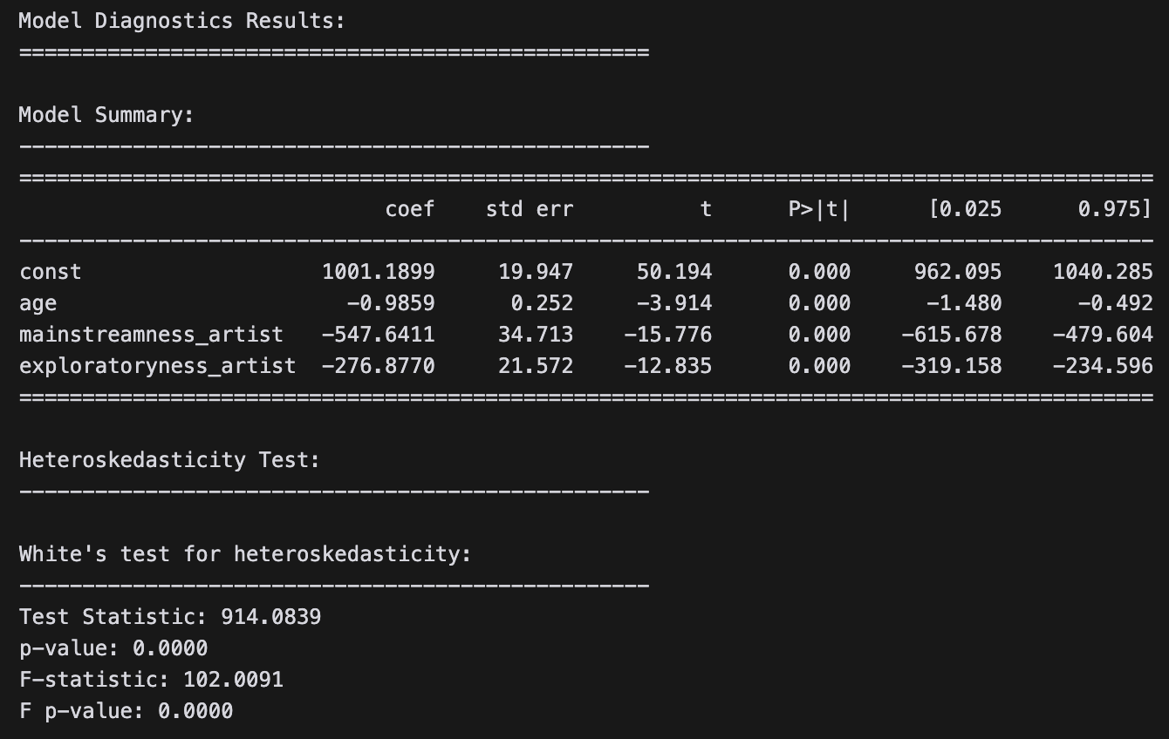
Model Diagnostics
Key Findings: In analyzing the diagnostic results, I found several important insights. The model summary reveals significant relationships between all predictors and listening behavior, with all p-values below 0.001.
Age:
Older users listen slightly less (-0.99 tracks/month), showing a modest negative effect.
This aligns with broader trends where younger users are typically more engaged.
Mainstreamness:
A strong negative effect (-547 tracks/month) suggests users who prefer mainstream music are far less active than those with other preferences. This could mean mainstream users are less engaged overall.
Exploratoryness:
A negative association (-277 tracks/month) might reflect the complexity of diverse listening behaviors, as high exploratoryness could be tied to sporadic but not sustained engagement.
(Test Statistic = 914.0839, p-value < 0.001), strongly indicating the presence of heteroskedasticity in the model.
Notes:
In analyzing the diagnostic results, I found several important insights. The model summary reveals significant relationships between all predictors and listening behavior, with all p-values below 0.001.
Age shows a slight negative relationship with listening behavior (coefficient = -0.9859), suggesting that older users tend to listen to slightly fewer tracks, though the effect is modest. More dramatically, mainstreamness_artist has a strong negative association (coefficient = -547.6411), indicating that users who prefer mainstream music tend to listen to significantly fewer tracks per month. Similarly, exploratoryness_artist also shows a substantial negative relationship (coefficient = -276.8770).
The White's test for heteroskedasticity yielded highly significant results (Test Statistic = 914.0839, p-value < 0.001), strongly indicating the presence of heteroskedasticity in the model. This suggests that the variance of our model's errors isn't constant across all predictions, which justifies the use of robust standard errors in our analysis.
The high F-statistic (102.0091) and its corresponding p-value (< 0.001) further confirm that the heteroskedasticity is not due to chance. This validates our decision to use robust estimation methods (HC3) in our earlier analysis to ensure reliable standard errors and confidence intervals.
These diagnostics suggest that while our model captures significant relationships, we need to be careful in our interpretation due to the presence of heteroskedasticity, and should rely on the robust standard errors for accurate inference.

Slide 14
Demographic Features Prediction
Ethical Issue: Can we predict demographic features by behavior data?
Models: Using listening behaviors to predict gender (female/male)
H0: The logistic regression model cannot identify gender
Model | Accuracy | ROC-AUC | Precision (Class 1) | Recall (Class 1) | F1-Score (Class 1)
Logistic Regression | 0.763 | 0.765022 | 0.778498 | 0.940147 | 0.851721
Random Forest | 0.784 | 0.798 | 0.821 | 0.900 | 0.858
Gradient Boosting | 0.790 | 0.810 | 0.824 | 0.902 | 0.861
SVM | 0.724 | 0.471901 | 0.724 | 1.0 | 0.839907
KNN | 0.658 | 0.505936 | 0.726841 | 0.845304 | 0.781609

Slide 15
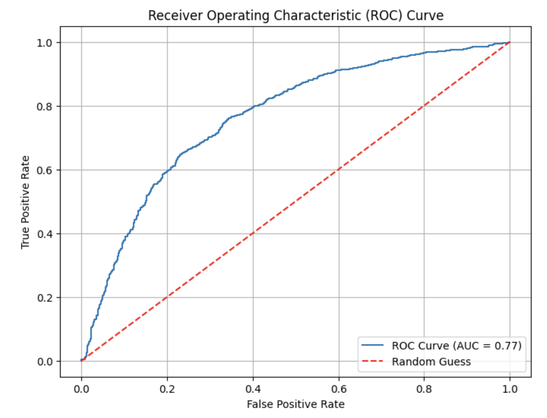
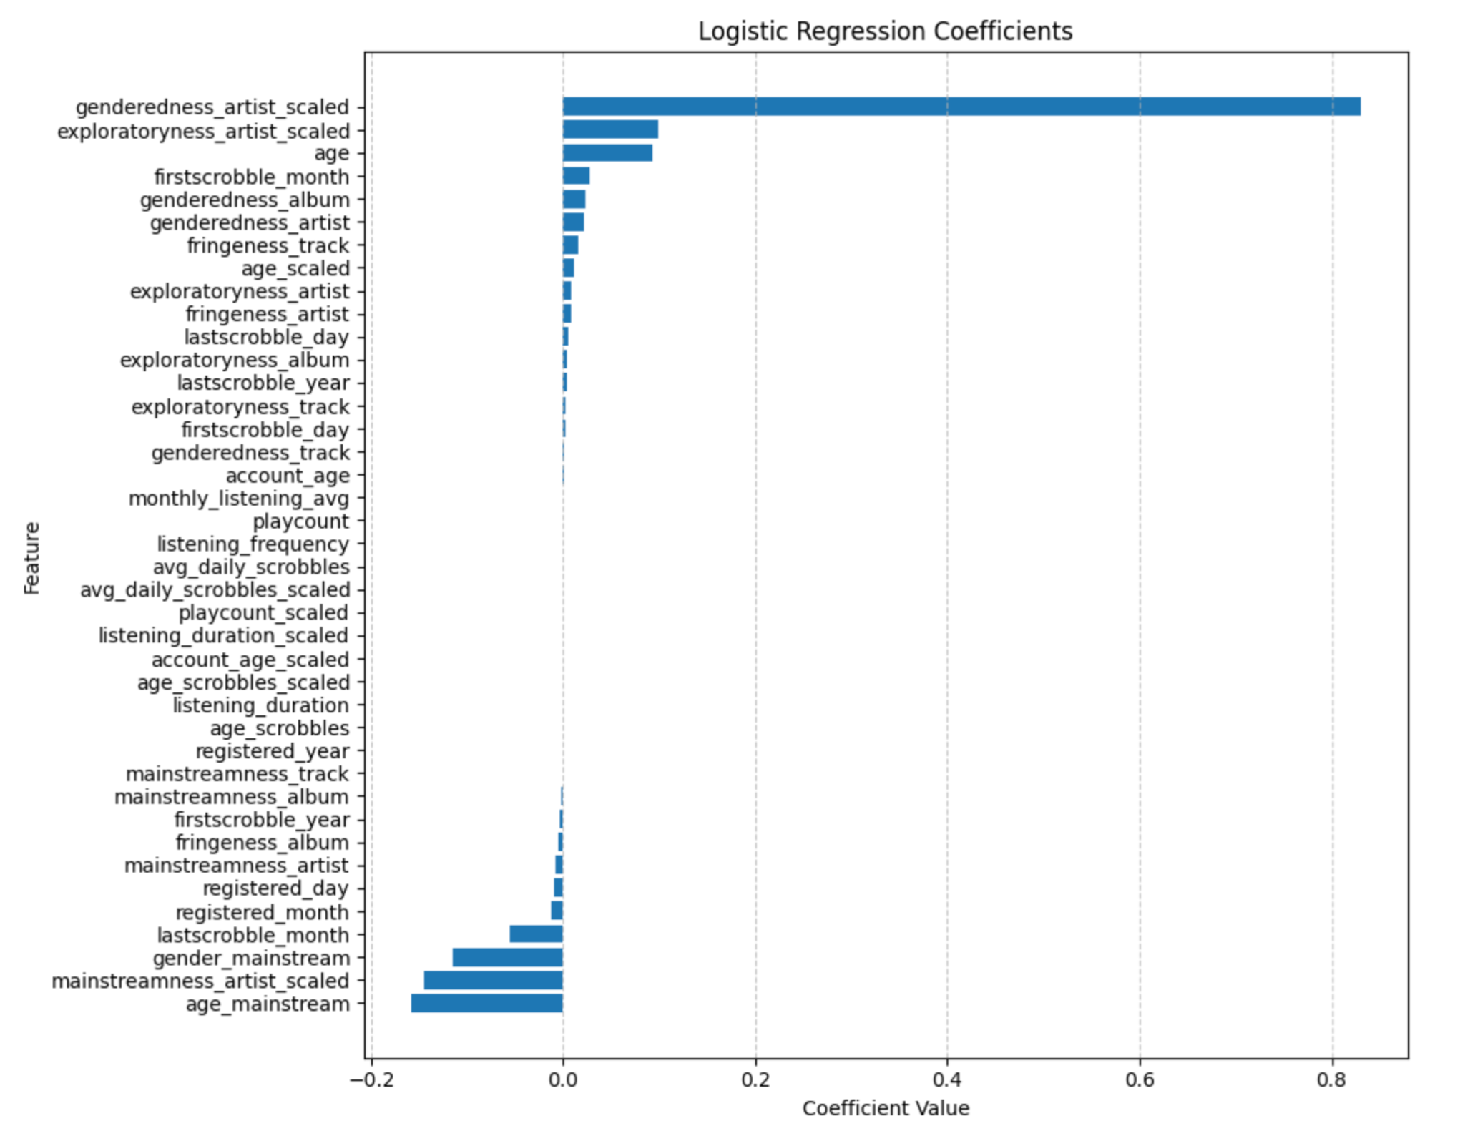
Logistic Regression: Gender Prediction
Successfully reject H0

Slide 16
Logistic Regression: Age Prediction
H0: The logistic regression model cannot identify age
Fail to reject H0

Slide 17
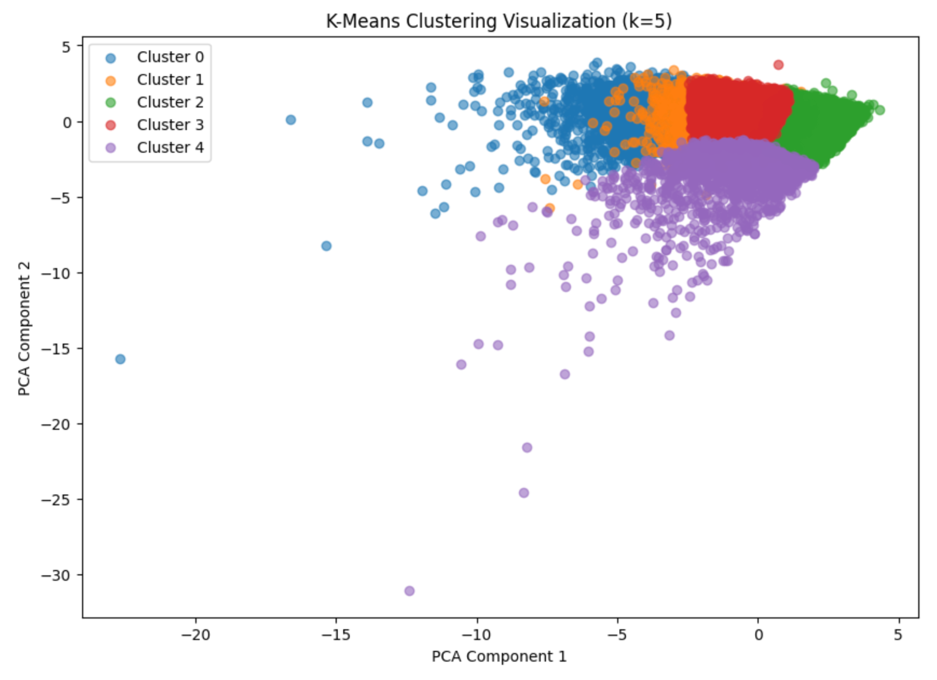
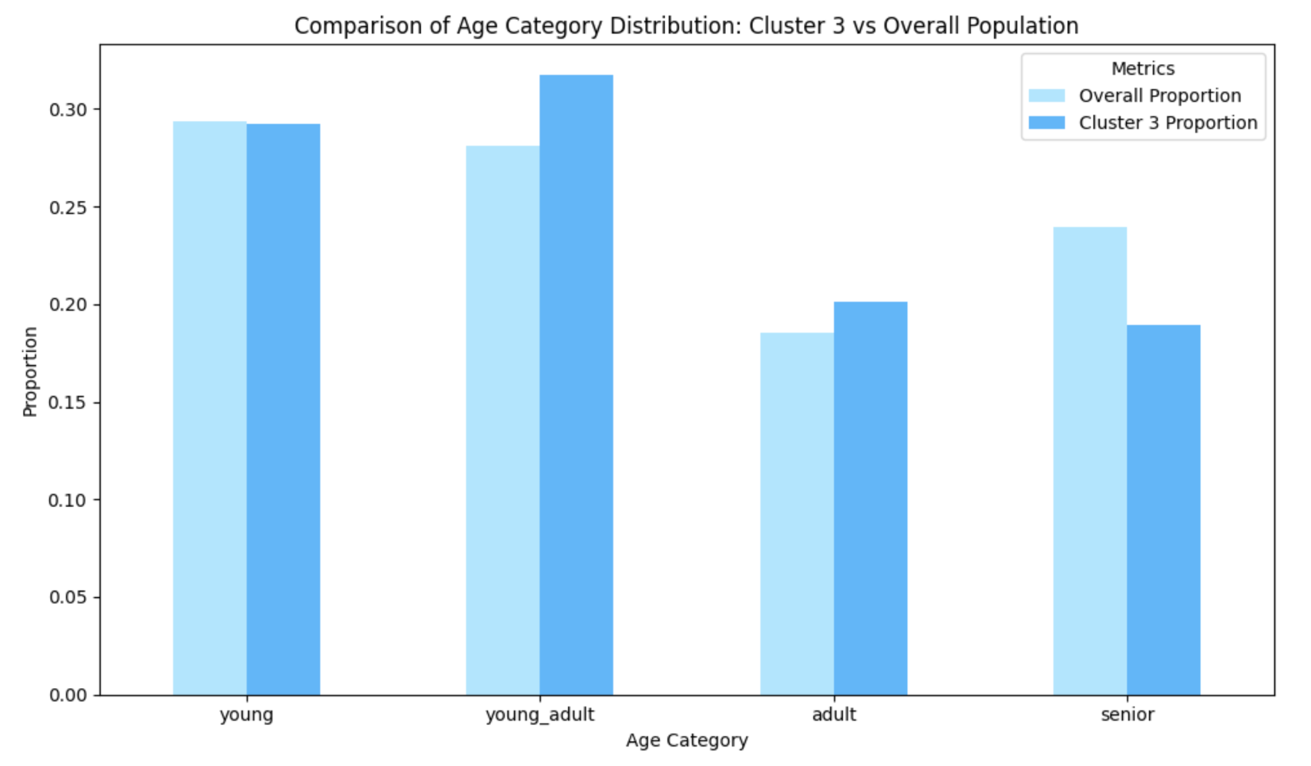
Linear Clustering: Who is highly engaged?
65.9% male and 12.7% female
Higher account age
Larger proportion of seniors
Curious Explorers
Highly Engaged Users
Mainstream Explorers
Diverse Moderates
Casual Mainstream Listeners

Slide 18
Business Insights
Age-Specific Content Strategies
Insight: Younger users (<30) prefer mainstream content, while older users (>45) gravitate toward niche music.
Create homepages tailored to age groups, emphasizing niche content for older users.
Foster community-building initiatives, such as playlist sharing for younger audiences.
Content Diversification
Insight: Non-mainstream users show higher engagement, indicating a preference for niche music.
Build recommendation systems spotlighting diverse and niche genres.
Partner with independent artists to deliver exclusive content.

Slide 19
Business Insights
Business Strategies For Highly Engaged Users:
Introduce premium features, exclusive content, or personalized subscription plans targeted at this group since they are likely to spend more time and resources on the platform.
Focus on loyalty programs, advanced recommendations, or priority customer support to retain this high-value segment.
Reduce Potential Privacy Risks: Pre-Publication Risk Assessment
Action: Conduct predictive modeling to identify potential privacy risks before publishing user data or insights derived from the data.
Implementation: Use differential privacy techniques or synthetic data generation to predict and test how the release of data might inadvertently expose sensitive user information.

